Slide 1
CEN 416: Assembly Language Programming
Interrupts and Interrupt system by
Omoruyi O.

Slide 2
Topic
Interrupts
Organisation of the interrupt system
Interrupt vectors
Implementation of single and multiple Interrupts

Slide 3
Interrupts
When you come to my office, and I have other business to attend to, I tell you to come back later.
What if you were with your Parents, out of a sense of respect, I will not do the same.
The smarter thing would be to stop my present activity and take care of your case.
In this case, human memory serves me because I will probably need to remember where I left off in that activity when I am through with you and your parents.

Slide 4
Interrupts
An Interrupt in a CPU is modelled in this way.
An interrupt is either a hardware-generated CALL (externally derived from a hardware signal) or a software-generated CALL (internally derived from the execution of an instruction or by some other internal event).
At times, an internal interrupt is called an exception. Either type interrupts the program by calling an interrupt service procedure (ISP) or interrupt handler.

Slide 5
Types of interrupt
There are two main types of interrupt in the 8086 microprocessor, internal and external hardware interrupts.
Internal interrupts are software calls like INT, INTO, and INT 3 or are initiated by the state of the CPU (e.g. divide by zero error) or by an instruction.
External interrupts are hardware type calls. Hardware interrupts occur when a peripheral device asserts an interrupt input pin of the microprocessor.

Slide 6
Sources of interrupts in 8086 microprocessor
One source is an external signal applied to the non-maskable interrupt (NMI) input pin or to the interrupt input pin.
A second source of an interrupt is execution of the interrupt instruction or other interrupt-type instruction. (e.g. INT, INTO etc.)
The third source of an interrupt is some error condition produced in the 8086 by the execution of an instruction. An example of this is the divide by zero interrupt.

Slide 7
The Operation of an Interrupt sequence on the 8086 Microprocessor:
1. External interface sends an interrupt signal, to the Interrupt Request (INTR) pin, or an internal interrupt occurs.
2. The CPU finishes the present instruction (for a hardware interrupt) and sends Interrupt Acknowledge (INTA) to hardware interface.
3. The interrupt type N is sent to the Central Processor Unit (CPU) via the Data bus from the hardware interface.
4. The contents of the flag registers are pushed onto the stack.
5. Both the interrupt (IF) and (TF) flags are cleared. This disables the INTR pin and the trap or single-step feature.
6. The contents of the code segment register (CS) are pushed onto the Stack.
7. The contents of the instruction pointer (IP) are pushed onto the Stack.
8. The interrupt vector contents are fetched, from (4 x N) and then placed into the IP and from (4 x N +2) into the CS so that the next instruction executes at the interrupt service procedure addressed by the interrupt vector.
9. While returning from the interrupt-service routine by the Interrupt Return (IRET) instruction, the IP, CS and Flag registers are popped from the Stack and return to their state prior to the interrupt.

Slide 8
Interrupt vectors
An interrupt vector is a 4-byte number stored in the first 1024 bytes of the memory(00000H–003FFH) when the microprocessor operates in the real mode.
In the protected mode, the vector table is replaced by an interrupt descriptor table that uses 8-byte descriptors to describe each of the interrupts. There are 256 different interrupt vectors, and each vector contains the address of an interrupt service procedure.

Slide 9
Intel interrupt vectors

Slide 10
Interrupt vectors
Table 4-1 lists the interrupt vectors, with a brief description and the memory location of each vector for the real mode. Each vector contains a value for IP and CS that forms the address of the interrupt service procedure.
The first 2 bytes contain the IP, and the last 2 bytes contain the CS. Here is a more detailed description of each vector:

Slide 11
Interrupt vectors
DIVIDE-BY-ZERO INTERRUPT-TYPE 0:
The 8086 will automatically do a type 0 interrupt if the result of a DIV operation or an IDIV operation is too large to fit in the destination register. For a type 0 interrupt, the 8086 pushes the flag register on the stack, resets IF and TF and pushes the return addresses on the stack.
SINGLE STEP INTERRUPT-TYPE 1:
The use of single step feature found in some monitor programs and debugger programs. When you tell a system to single step, it will execute one instruction and stop. If they are correct we can tell a system to single step, it will execute one instruction and stop. We can then examine the contents of registers and memory locations. In other words, when in single step mode a system will stop after it executes each instruction and wait for further direction from you. The 8086 trap flag and type 1 interrupt response make it quite easy to implement a single step feature direction.
NON-MASKABLE INTERRUPT-TYPE 2:
The 8086 will automatically do a type 2 interrupt response when it receives a low to high transition on its NMI pin. When it does a type 2 interrupt, the 8086 will push the flags on the stack, reset TF and IF, and push the CS value and the IP value for the next instruction on the stack. It will then get the CS value for the start of the type 2 interrupt service procedure from address 0000AH and the IP value for the start of the procedure from address 00008H.

Slide 12
Interrupt Vectors
BREAKPOINT INTERRUPT-TYPE 3:
The type 3 interrupt is produced by execution of the INT3 instruction. The main use of the type 3 interrupt is to implement a breakpoint function in a system. When we insert a breakpoint, the system executes the instructions up to the breakpoint and then goes to the breakpoint procedure. Unlike the single step which stops execution after each instruction, the breakpoint feature executes all the instructions up to the inserted breakpoint and then stops execution.
OVERFLOW INTERRUPT-TYPE4:
The 8086 overflow flag will be set if the signed result of an arithmetic operation on two signed numbers is too large to be represented in the destination register or memory location. For example, if you add the 8 bit signed number 01101100 and the 8 bit signed number 010111101, the result will be 10111101. This would be the correct result if we were adding unsigned binary numbers, but it is not the correct signed result.

Slide 13
Interrupt vectors
SOFTWARE INTERRUPTS-TYPE 0 THROUGH 255:
The 8086 INT instruction can be used to cause the 8086 to do any one of the 256 possible interrupt types. The desired interrupt type is specified as part of the instruction. The instruction INT 32, for example will cause the 8086 to do a type 32 interrupt response. The 8086 will push the flag register on the stack, reset TF and IF, and push the CS and IP values of the next instruction on the stack.
INTR INTERRUPTS-TYPES 0 THROUGH 255:
The 8086 INTR input allows some external signal to interrupt execution of a program. Unlike the NMI input, however, INTR can be masked so that it cannot cause an interrupt. If the interrupt flag is cleared, then the INTR input is disabled. IF can be cleared at any time with CLEAR instruction.

Slide 14
Interrupt vectors
The address of the interrupt vector is determined by multiplying the interrupt type number by 4. For example, the INT 10H instruction calls the interrupt service procedure whose address is stored beginning at memory location 40H (10H × 4) in the real mode.
In the protected mode, the interrupt descriptor is located by multiplying the type number by 8 instead of 4 because each descriptor is 8 bytes long.
Each INT instruction is 2 bytes long. The first byte contains the opcode, and the second byte contains the vector type number. The only exception to this is INT 3, a 1-byte special software interrupt used for breakpoints.

Slide 15
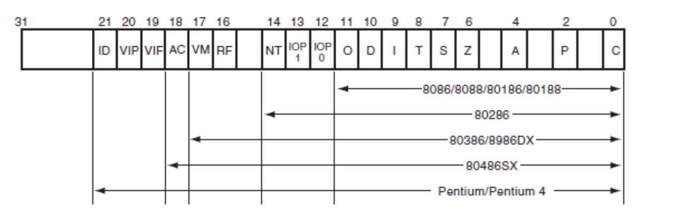
Extended Flags

Slide 16
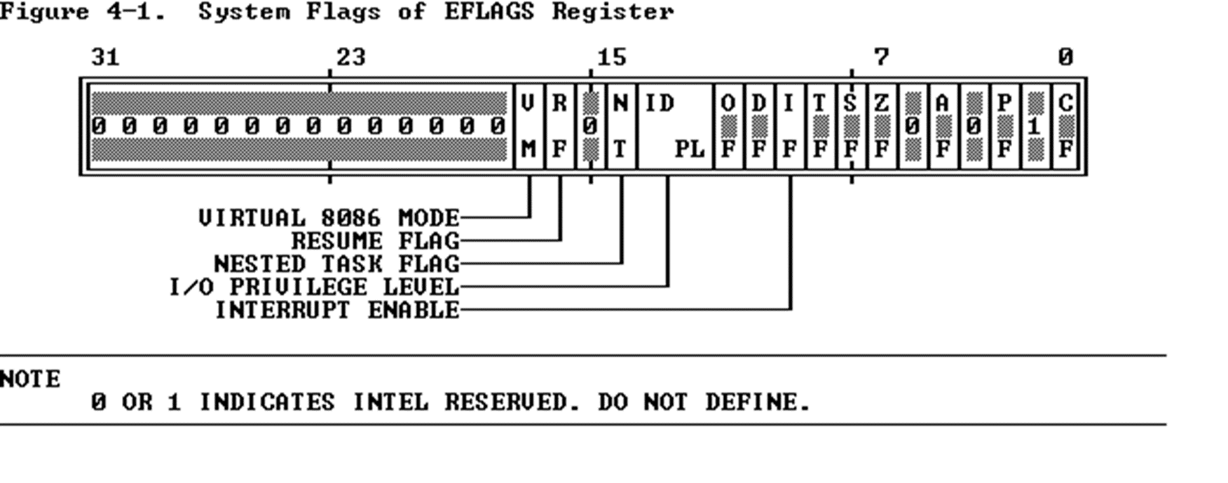
Extended Flags

Slide 17
Extended Flags
The systems flags of the EFLAGS register control I/O, maskable interrupts, debugging, task switching, and enabling of virtual 8086 execution in a protected, multitasking environment. These flags are highlighted in Figure shown in the previous page.
IF (Interrupt-Enable Flag, bit 9)
Setting IF allows the CPU to recognize external (maskable) interrupt requests. Clearing IF disables these interrupts. IF has no effect on either exceptions or non-maskable external interrupts .
NT (Nested Task, bit 14)
The processor uses the nested task flag to control chaining of interrupted and called tasks. NT influences the operation of the IRET instruction .

Slide 18
Extended Flags
RF (Resume Flag, bit 16)
The RF flag temporarily disables debug exceptions so that an instruction can be restarted after a debug exception without immediately causing another debug exception .
TF (Trap Flag, bit 8)
Setting TF puts the processor into single-step mode for debugging. In this mode, the CPU automatically generates an exception after each instruction, allowing a program to be inspected as it executes each instruction. Single-stepping is just one of several debugging features of the 80386 .
VM (Virtual 8086 Mode, bit 17)
When set, the VM flag indicates that the task is executing an 8086 program . Refer to Chapter on protected mode (Barry Brey text) for a detailed discussion of how the 80386 executes 8086 tasks in a protected, multitasking environment.

Slide 19
PRIORITY OF 8086 INTERRUPTS
If two or more interrupts occur at the same time then the highest priority interrupt will be serviced first, and then the next highest priority interrupt will be serviced.
As a example suppose that the INTR input is enabled, the 8086 receives an INTR signal during the execution of a divide instruction, and the divide operation produces a divide by zero interrupt. Since the internal interrupts-such as divide error, INT, and INTO have higher priority than INTR the 8086 will do a divide error interrupt response first.

Slide 20
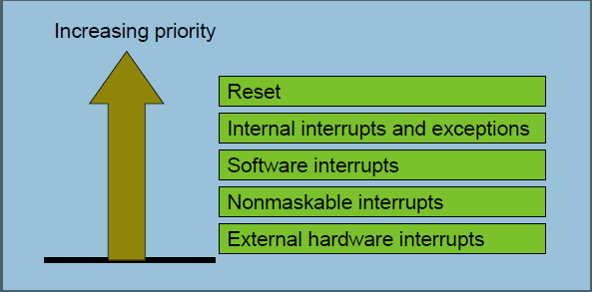
Priority of interrupts in 8086

Slide 21
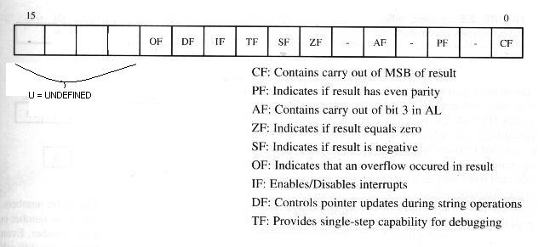

Flag register

Slide 22
8086 Interrupt Pins and Timing
INTR: Interrupt Request. Activated by a peripheral device to interrupt the processor.
Level triggered. Activated with a logic 1.
INTA: Interrupt Acknowledge. Activated by the processor to inform the interrupting device the interrupt request (INTR) is accepted.
Level triggered. Activated with a logic 0.
NMI: Non-Maskable Interrupt. Used for major system faults such as parity errors and power failures.
Edge triggered. Activated with a positive edge (0 to 1) transition.
Must remain at logic 1, until it is accepted by the processor.
Before the 0 to 1 transition, NMI must be at logic 0 for at least 2 clock cycles.
No need for interrupt acknowledgement.

Slide 23
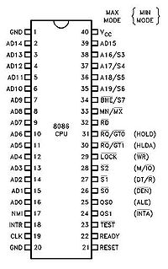
8086 Pin diagram

Slide 24
Single Interrupt lines
The microprocessor only has one interrupt request (INTR) line which is triggered by a 1 signal. All hardware devices use this line to generate an interrupt request.
When say the INTR line goes high the microprocessor does not have enough information to determine which of the possible interrupting devices is requesting attention. The device must be identified in order for the microprocessor to run the appropriate service routine.

Slide 25
Multiple Interrupts
If more than one device is connected to the interrupt line, the processor needs to know to which device service routine it should branch to. The identification of the device requesting service can be done in either hardware or software, or a combination of both. The three main methods are:
Software Polling,
Hardware Polling, (Daisy Chain),
Hardware Identification (Vectored Interrupts).

Slide 26
Software Polling
A software routine is used to identify the device requesting service. A simple polling technique is used, each device is checked to see if it was the one needing service.
Having identified the device, the processor then branches to the appropriate interrupt-handling-routine address for the given device. The order in which the devices appear in the polling sequence determines their priority

Slide 27
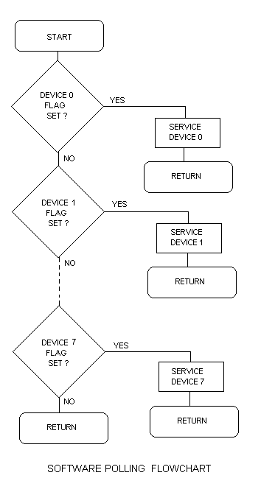
Software polling

Slide 28
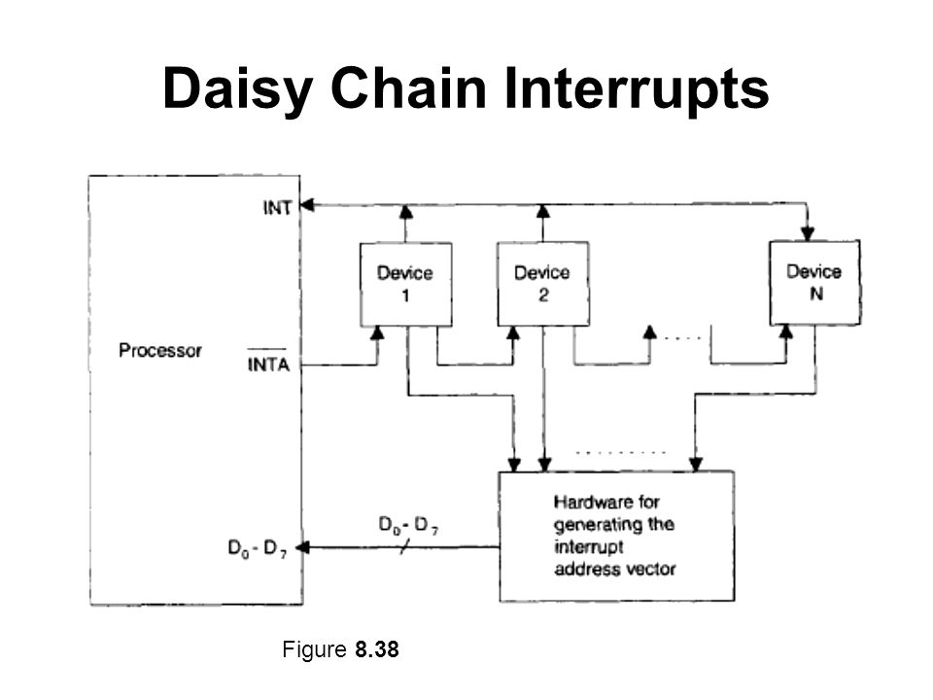
Hardware polling (Daisy Chain)
This is significantly faster than a pure software approach. A daisy chain is used to identify the device requesting service.

Slide 29
Daisy chaining
Daisy chaining is used for level sensitive interrupts, which act like a wired 'OR' gate. Any requesting device can take the interrupt line low, and keep it asserted low until it is serviced. Because more than one device can assert the shared interrupt line simultaneously, some method must be employed to ensure device priority. This is done using the interrupt acknowledge signal generated by the processor in response to an interrupt request. Each device is connected to the same interrupt request line, but the interrupt acknowledge line is passed through each device, from the highest priority device first, to the lowest priority device last.
After preserving the required registers, the microprocessor generates an interrupt acknowledge signal. This is gated through each device. If device 1 generated the interrupt, it will place its identification signal on the data bus, which is read by the processor, and used to generate the address of the interrupt-service routine. If device 1 did not request the servicing, it will pass the interrupt acknowledge signal on to the next device in the chain. Device 2 follows the same procedure, and so on.

Slide 30
Hardware Identification (Vectored Interrupts)
This is the fastest system. The onus is placed on the requesting device to request the interrupt, and identify itself. The identity could be a branching address for the desired interrupt-handling routine.
If the device just supplies an identification number, this can be used in conjunction with a lookup table to determine the address of the required service routine. Response time is best when the device requesting service also supplies a branching address.

Slide 31
PIC (Priority Interrupt Controllers)
Priority Interrupt Controller Chips (PIC's) are hardware chips designed to make the task of a device presenting its own address to the CPU simple. The PIC also assesses the priority of the devices connected to it. Modern PIC's can also be programmed to prevent the generation of interrupts which are lower than a desired level.
The decoded location is connected to the output of a priority encoder. The input of the priority encoder is connected to each device. When a device requests service, the priority encoder presents a special code combination (unique for each device) to the decoded memory location. The port thus holds the value or address associated with the highest device requesting service.
The priority encoder arranges all devices in a list, devices given a lower priority are serviced when no other higher priority devices need servicing. This simplifies the software required to determine the device, resulting in an increase in speed.

Slide 32
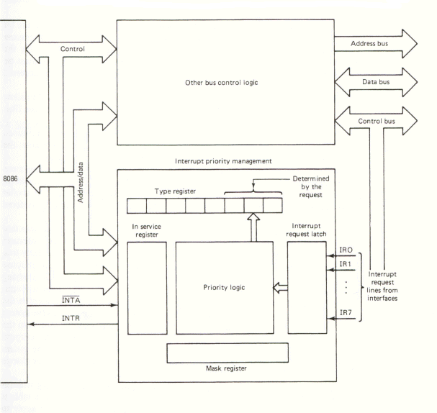
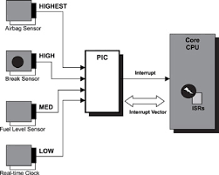
PIC (Priority Interrupt Controller)

Slide 33
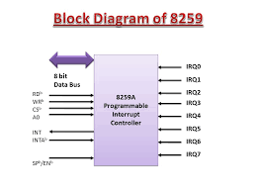
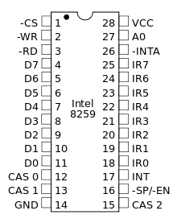
PIC (Intel 8259)

Slide 34
8259a Priority Interrupt Controller
In a small system, for example, we might read ASCII characters in from a keyboard on an interrupt basis; count interrupts from timer to produce a real time clock of second, minutes and hours and detect several emergency or job done conditions on an interrupt basis. Each of these interrupt applications requires a separate interrupt input. If we are working with an 8086 , we have problem here because the 8086 has only two interrupt inputs, NMI and INTR. If we save NMI for a power failure interrupt, this leaves only one input for all the other applications. For applications where we have interrupts from multiple sources, we use an external device called a priority interrupt controller.

Slide 35
Interrupt Applications
Hardware Interrupt Applications:
- Simple Interrupt Data Input
- Counting Applications
- Timing Applications:
Software interrupts are used to call Basic Input Output System, or BIOS, procedures in an IBM PC-type computer.
Software interrupt instruction INT N can be used to test any other type of interrupt procedure.

Slide 36
Conclusion
Thank you!

Slide 37
References
The Intel Microprocessor, Architecture, Programming and Interfacing, 6th Ed., by Barr B Brey.
2. An introduction to interrupts http://www.electronics.dit.ie/staff/tscarff/Interrupts/interrupts.htm
3. Interrupts and Interrupt applications: https://www.ukessays.com/essays/education/interrupts-and-interrupt-applications.php
4. Interrupts and Polling: LCS, Edinburgh Lecture notes

